Slide 1




BUSINESS AND COMPETITIVE ANALYSIS
A Comprehensive Case Study on Sales, Performance, and Market Insights
Presented by Kirubha Mahesan

Slide 2




Introduction to D-Mart Case Study
This case study aims to provide an in-depth analysis of D-Mart's business performance and competitive positioning.
Key Objectives:
Assess market trends.
Gain sales insights.
Identify strategic growth areas in the evolving retail landscape.
The study focuses on data from FY 2012-2024, with insights on revenue, sales trends, and customer demographics.

Slide 3

Market Overview & Competitive Landscape
D-Mart operates in a highly competitive retail space with key players like Reliance Retail, Big Bazaar, Amazon, and Flipkart.
D-Mart’s competitive edge is its low-cost business model, but it faces challenges from online giants like Amazon.
Key Competitors:
Reliance Retail: Scalability and market penetration.
Big Bazaar: Urban middle-class customers.
Amazon/Flipkart: E-commerce convenience and variety.

Slide 4
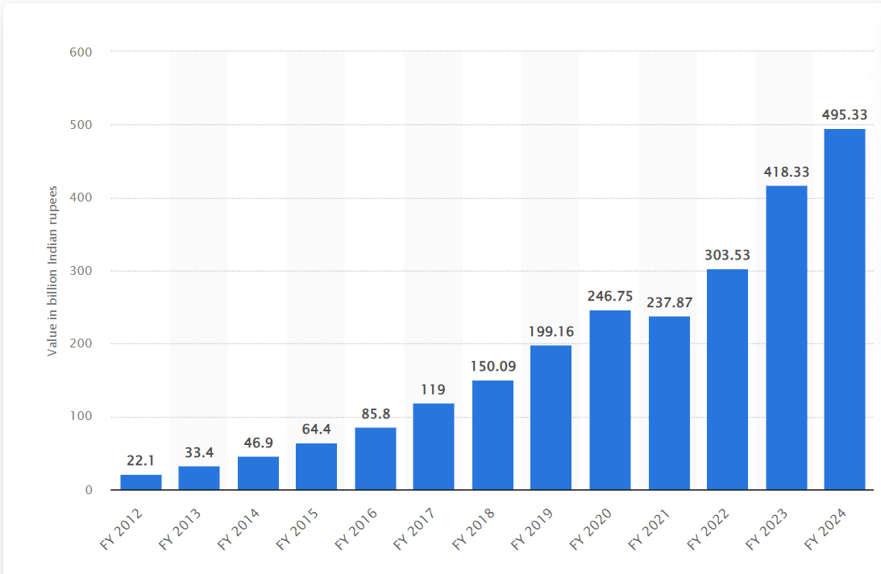
D-Mart Business Performance
(FY 2012-2024)
D-Mart has seen a ten-fold increase in revenue from ₹22.1 billion in FY 2012 to ₹495 billion in FY 2024.
This growth reflects the brand’s successful expansion and market strategy.

Slide 5
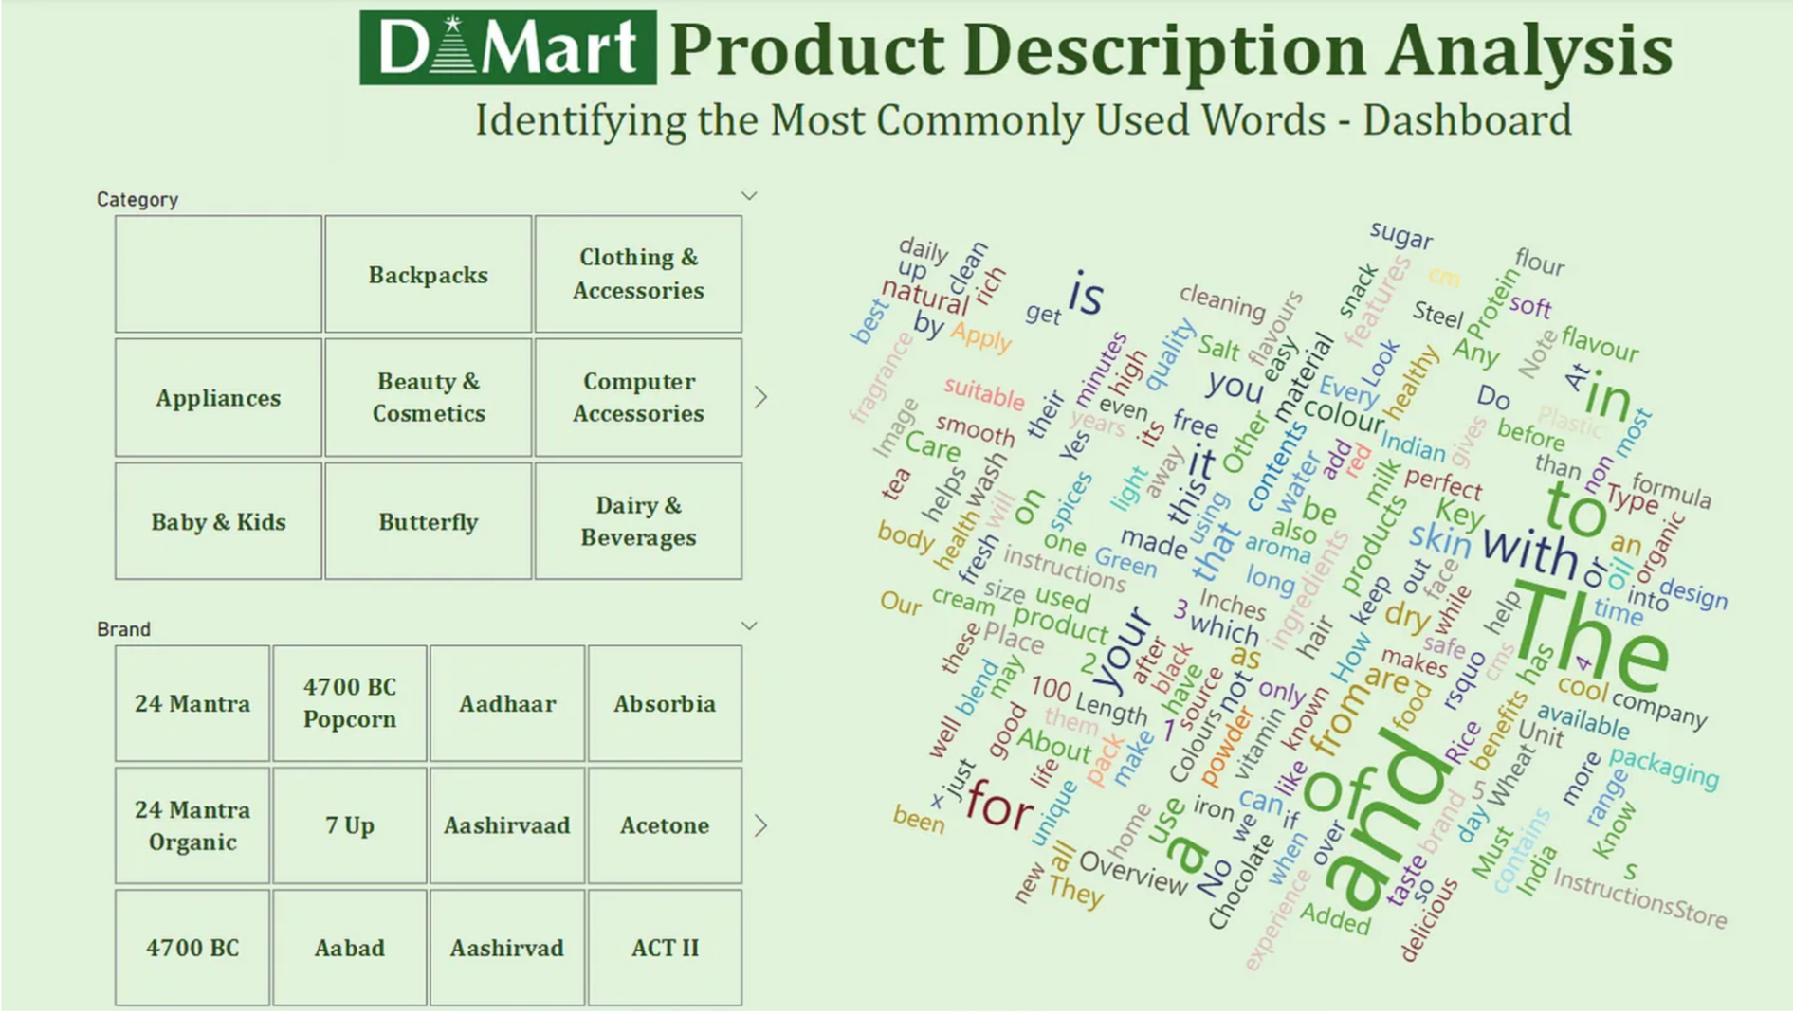


Customer Insights
Key Demographics:
47% of D-Mart shoppers are millennials.
D-Mart has more male than female shoppers.
Most shoppers are urban, high-income earners.

Slide 6
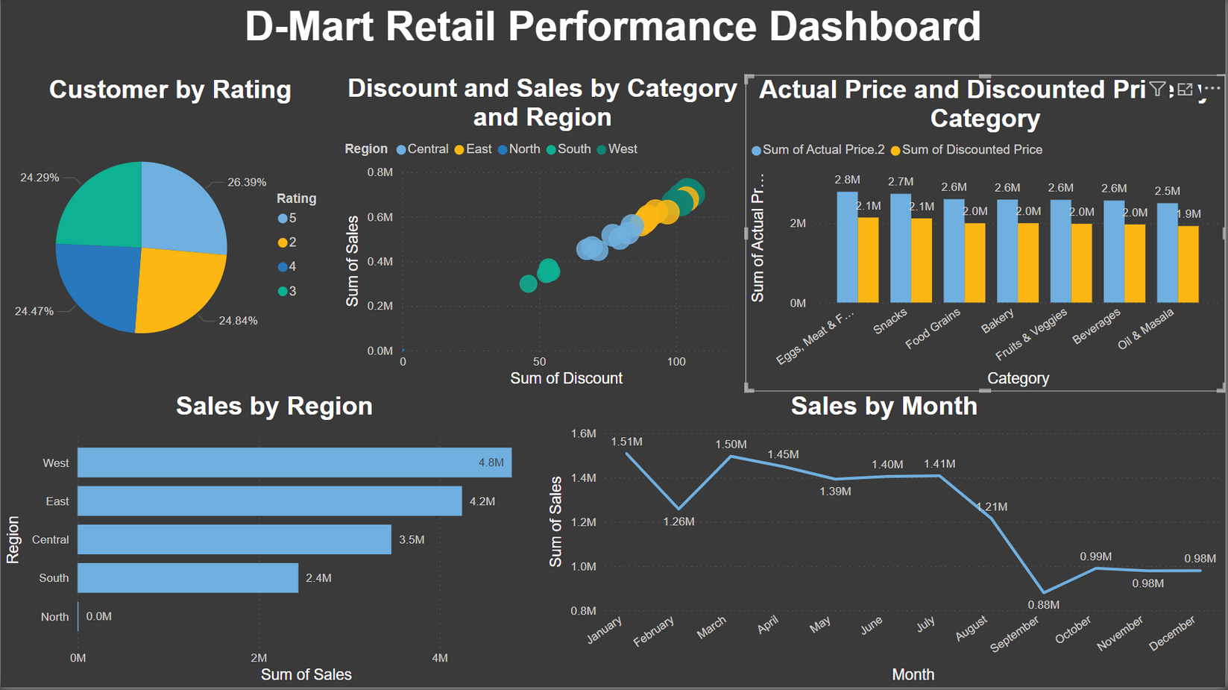
Sales and Discount Analysis
D-Mart leverages discount strategies to drive sales, with an average discount of 26.42% across categories.
Regional Performance:
The West and East regions are top performers, contributing the most to total sales.

Slide 7
SWOT Analysis
Strengths
Weaknesses
Opportunities
Threats
Low-cost business model: Competitive pricing attracts price-sensitive consumers.
Strong supply chain: Efficient operations help maintain low prices and manage high volumes.
Limited online presence: Weak e-commerce platform compared to Amazon and Flipkart.
Geographic concentration: Heavy reliance on specific regions (e.g., West and South India).
E-commerce expansion: Huge potential to develop a more robust online presence.
Untapped markets: Growth potential in North and Central India.
Increasing competition: Amazon, Flipkart, and Reliance Retail dominate in online and offline segments.
Changing consumer behavior: Shift towards online shopping could affect physical stores.

Slide 8
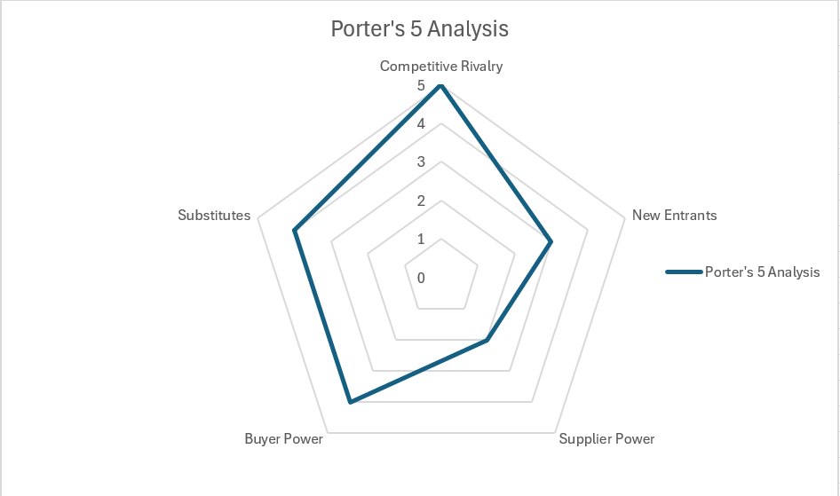
Porter's 5 Forces Analysis
Competitive Rivalry (High):
Highly competitive retail space with major players like Amazon, Flipkart, and Reliance Retail.
D-Mart competes based on price, but lacks online scalability.
Threat of New Entrants (Moderate):
High barriers to entry due to established players and brand loyalty.
E-commerce has lower barriers, which increases competition.
Bargaining Power of Suppliers (Low):
D-Mart has strong bargaining power with suppliers due to its scale.
Can negotiate for lower prices, helping maintain its low-cost model.
Bargaining Power of Buyers (High):
Buyers have high bargaining power due to multiple shopping options (online and offline).
Customers expect low prices, driving intense competition.
Threat of Substitutes (High):
Growing preference for online shopping (Amazon, Flipkart) is a major threat to physical stores.
Other offline competitors like Big Bazaar and local grocery stores offer alternatives.

Slide 9
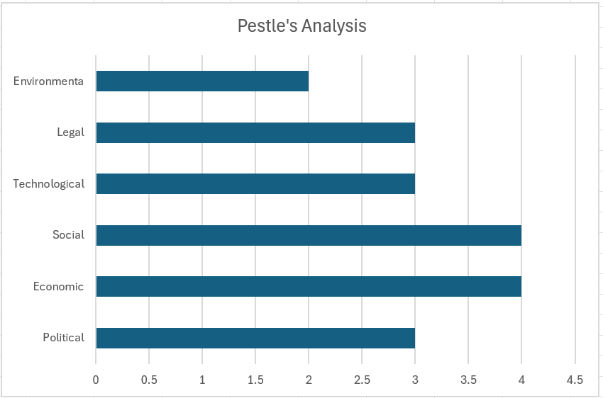
PESTLE Analysis of D-Mart
1. Political:
Favorable government policies for retail sector growth.
Impact of taxation policies and regulations on supply chain and pricing strategies.
2. Economic:
Growth in disposable incomes driving consumer spending.
Inflation and changes in the cost of goods can affect margins.
3. Social:
Increasing preference for convenience shopping and online platforms.
Growing urban population with a high demand for affordable goods.
4. Technological:
Advancements in e-commerce and digital payments impacting retail.
D-Mart’s lagging digital infrastructure needs improvement.
5. Legal:
Compliance with labor laws, taxation, and consumer protection regulations.
Must adhere to environmental laws in terms of sustainable practices.
6. Environmental:
Increasing emphasis on sustainability and eco-friendly business models.
Potential opportunities in offering organic products and sustainable packaging.

Slide 10

Strategic Recommendations
E-commerce Expansion: D-Mart should invest in its online platform to compete with Amazon and Flipkart.
Geographical Expansion: Open new stores in North and Central regions to tap into under-served markets.
Customer Retention: Implement loyalty programs to retain customers.
Price Optimization: Use customer data to implement targeted pricing strategies based on competitive benchmarking.

Slide 11

Methodology
Frameworks Used
Data Sources
SWOT: Strengths, Weaknesses, Opportunities, Threats.
Porter’s 5 Forces: Market competition and power dynamics.
PESTLE: External factors like political, social, and economic trends.
Sales data, customer insights, and market reports.
Tools used: Power BI and Excel for data visualization and analysis.

Slide 12
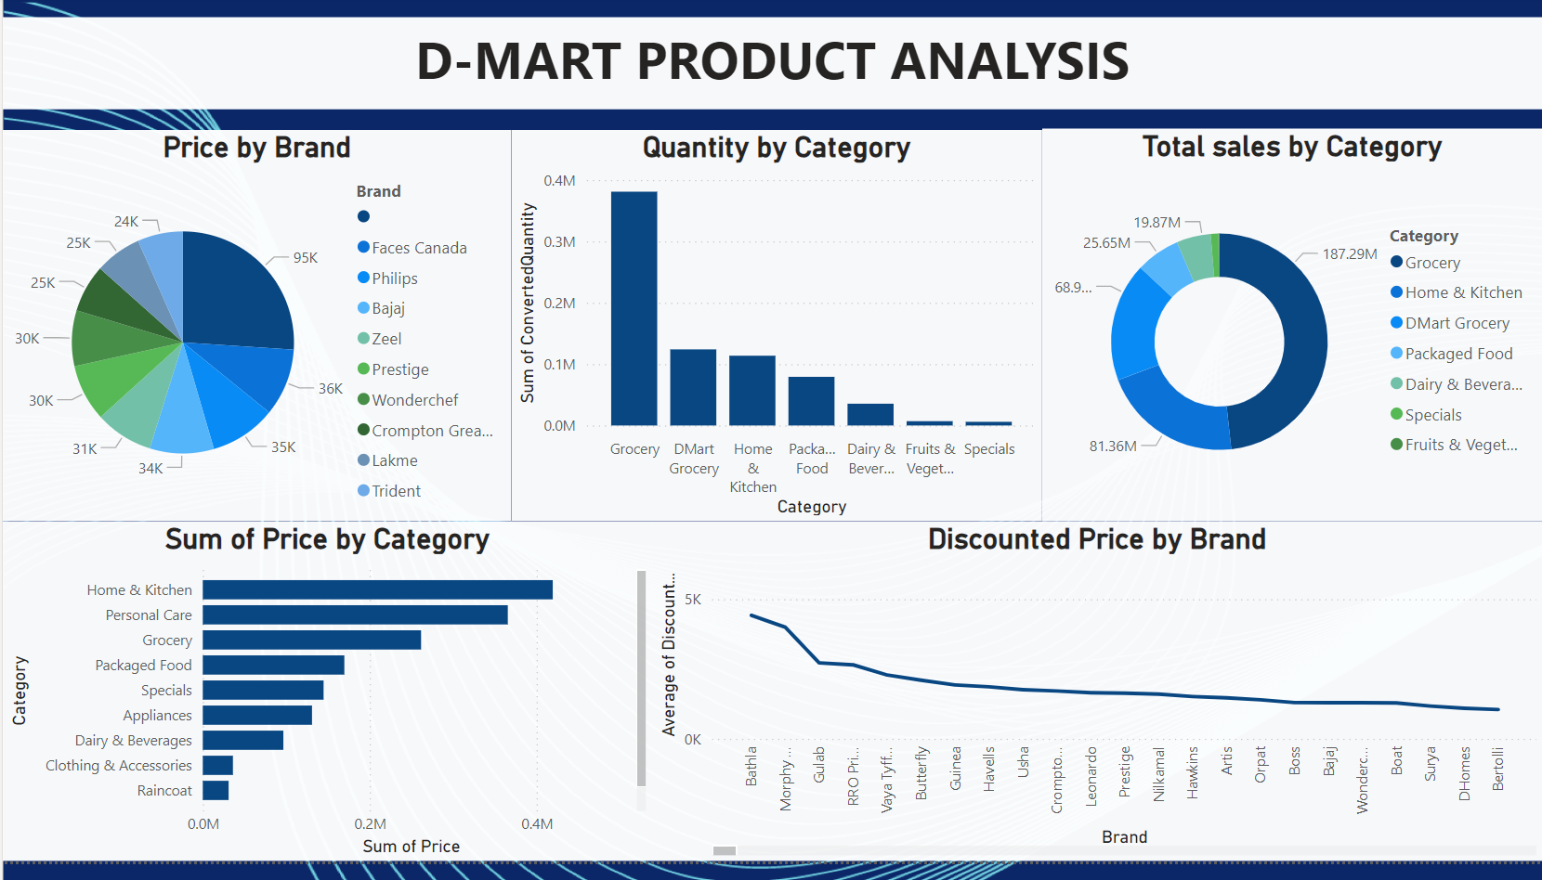

Slide 13

Conclusion
D-Mart has achieved remarkable growth, solidifying its position as a leading low-cost retailer in India. However, with increasing competition from e-commerce giants like Amazon and Flipkart, the company must focus on strengthening its online presence and expanding into underserved regions. By leveraging customer insights, optimizing pricing strategies, and investing in digital transformation, D-Mart can maintain its competitive advantage and continue its upward growth trajectory.

Slide 14

Citations
STATISTA, D-MART REVENUE FY 2012-2024.
Internal D-Mart Sales Data and ANALYSIS.
COMPETITIVE BENCHMARKING: RELIANCE RETAIL, AMAZON, BIG BAZAAR.
INDUSTRY REPORTS AND MARKET DATA.

Slide 15
THANK YOU
SO MUCH!
Presented by Kirubha Mahesan

